Slide 1




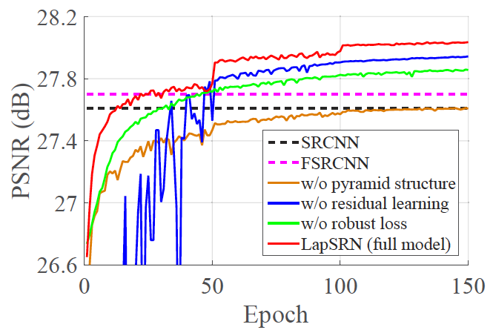
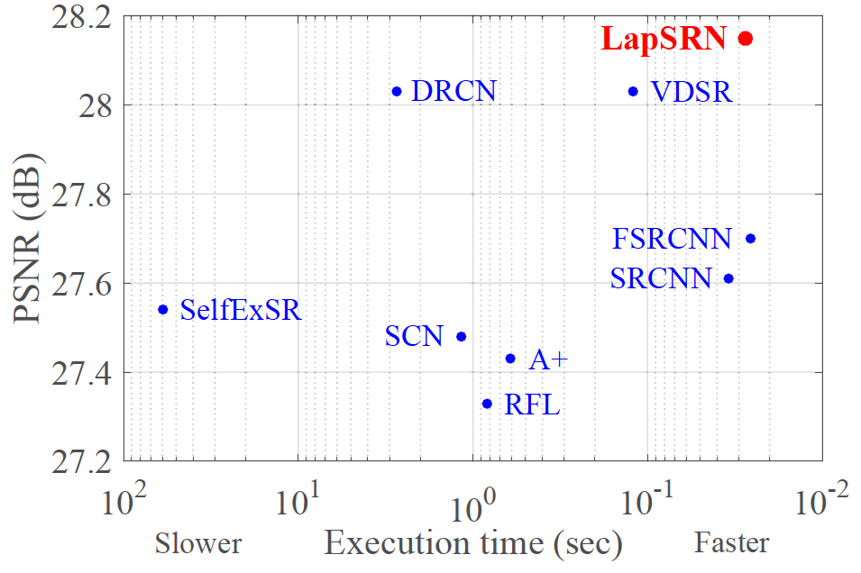
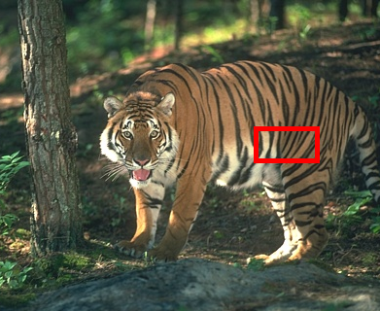

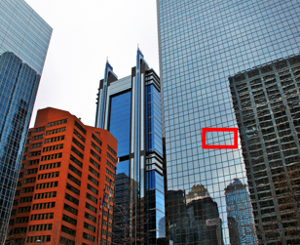




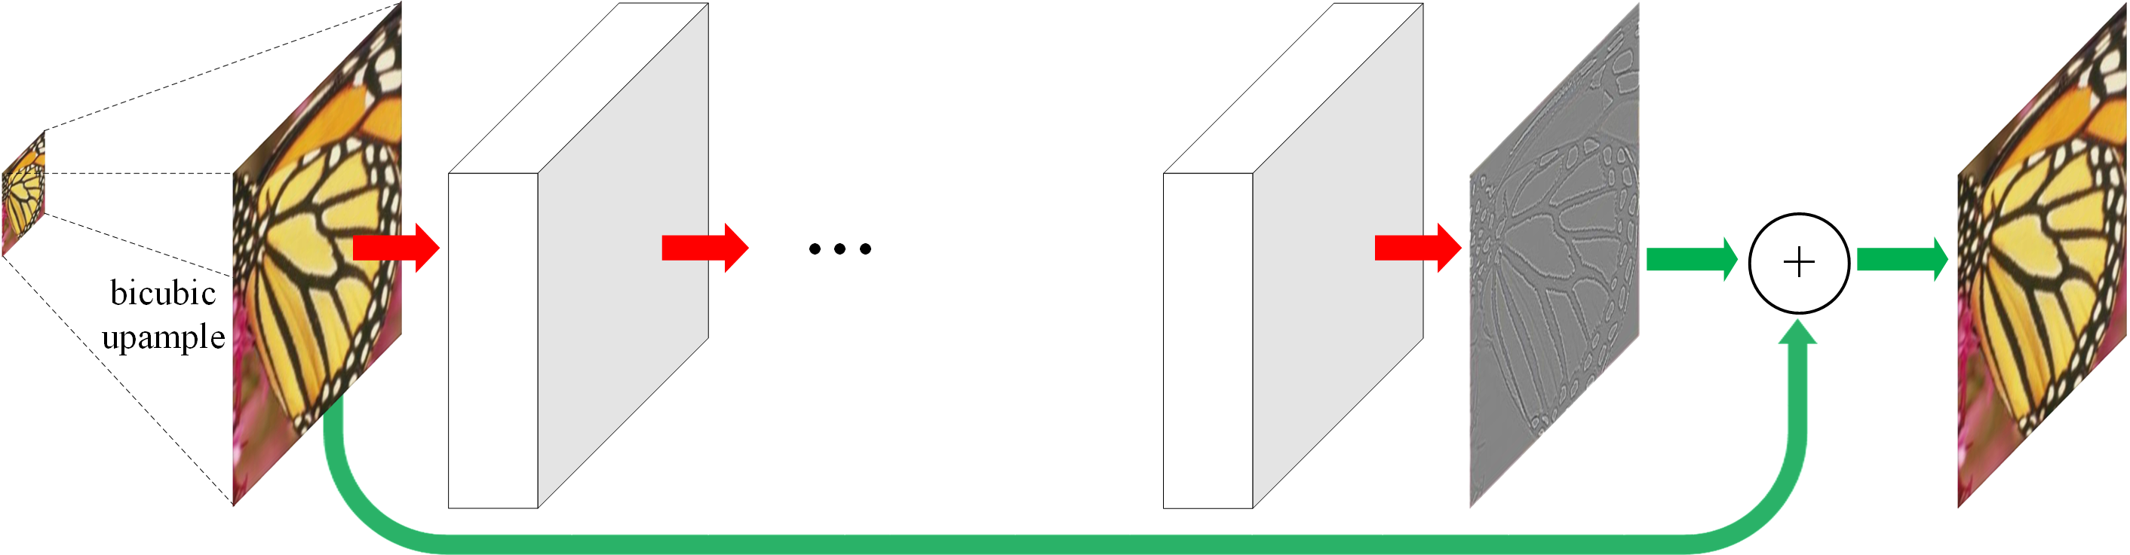
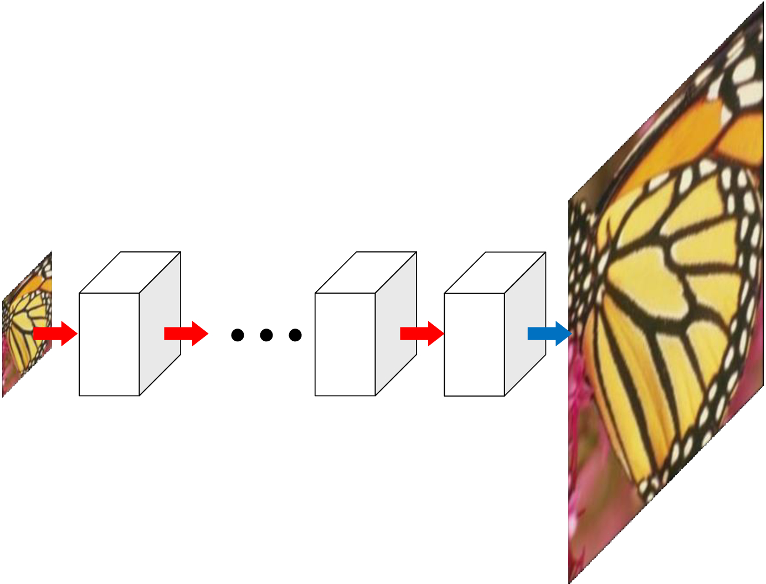




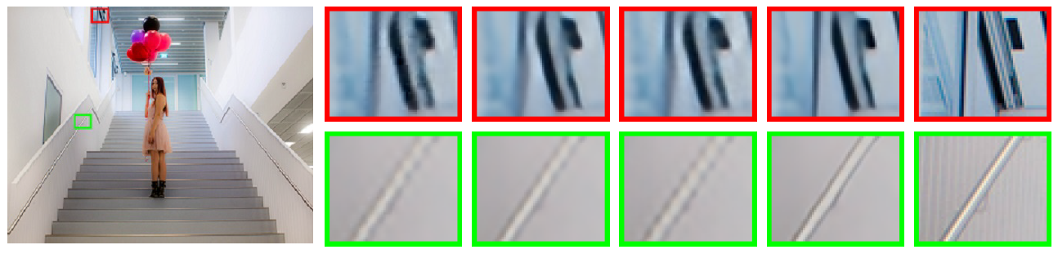
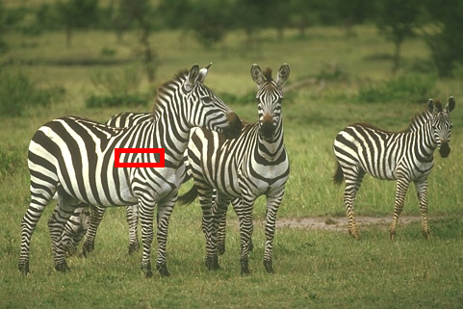
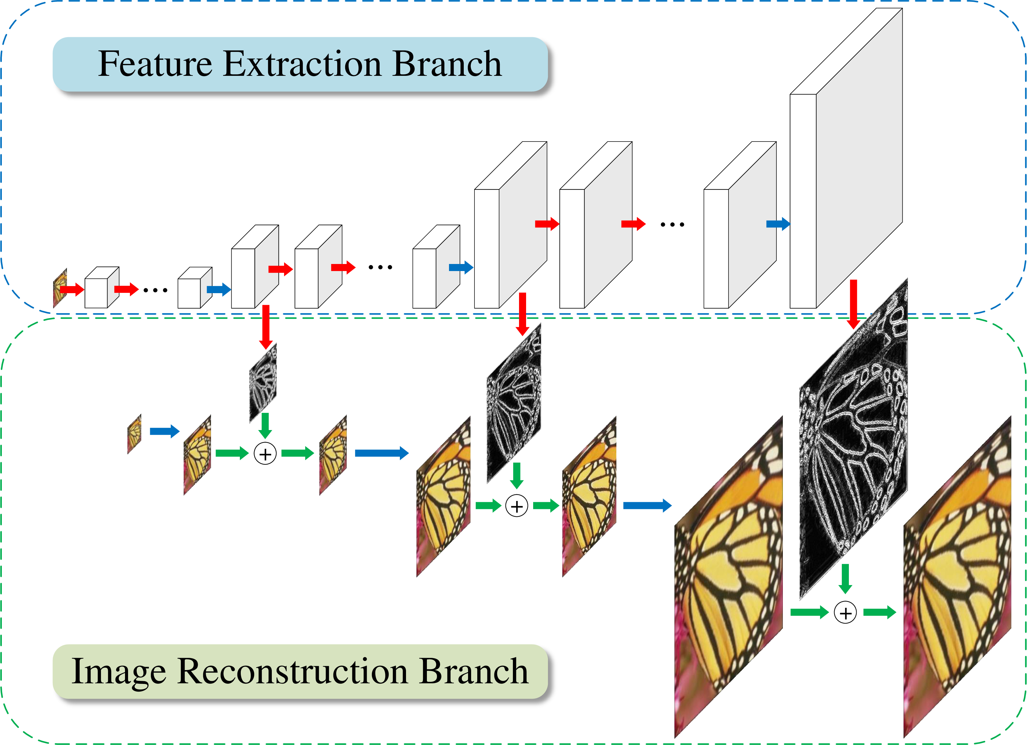
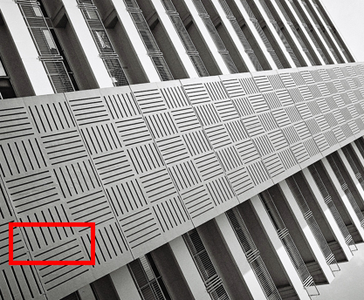








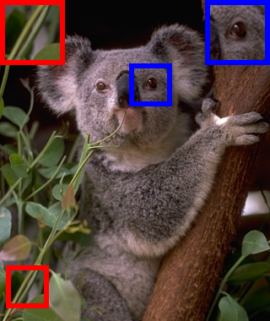


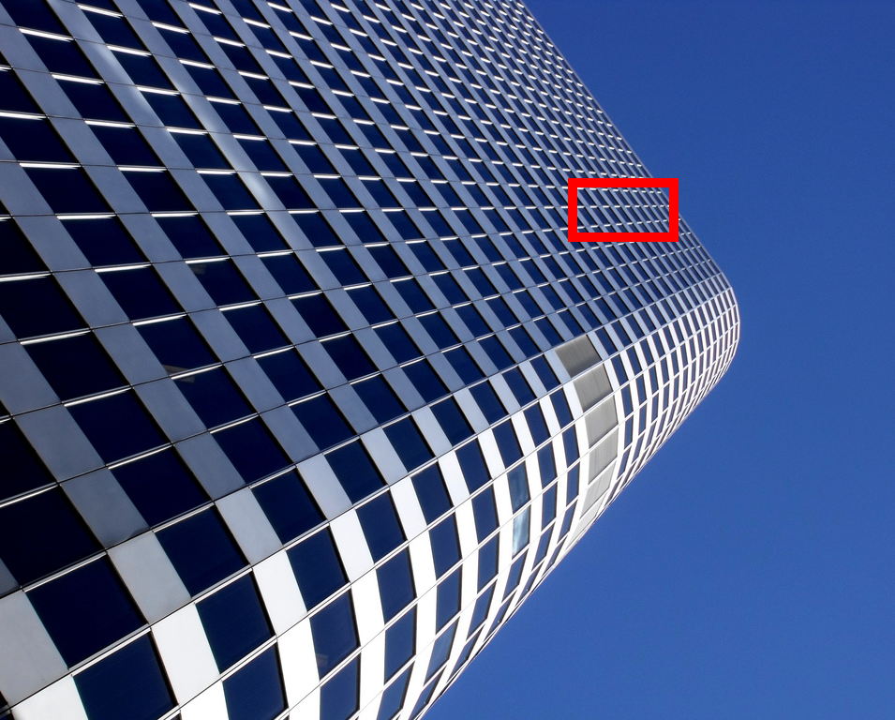




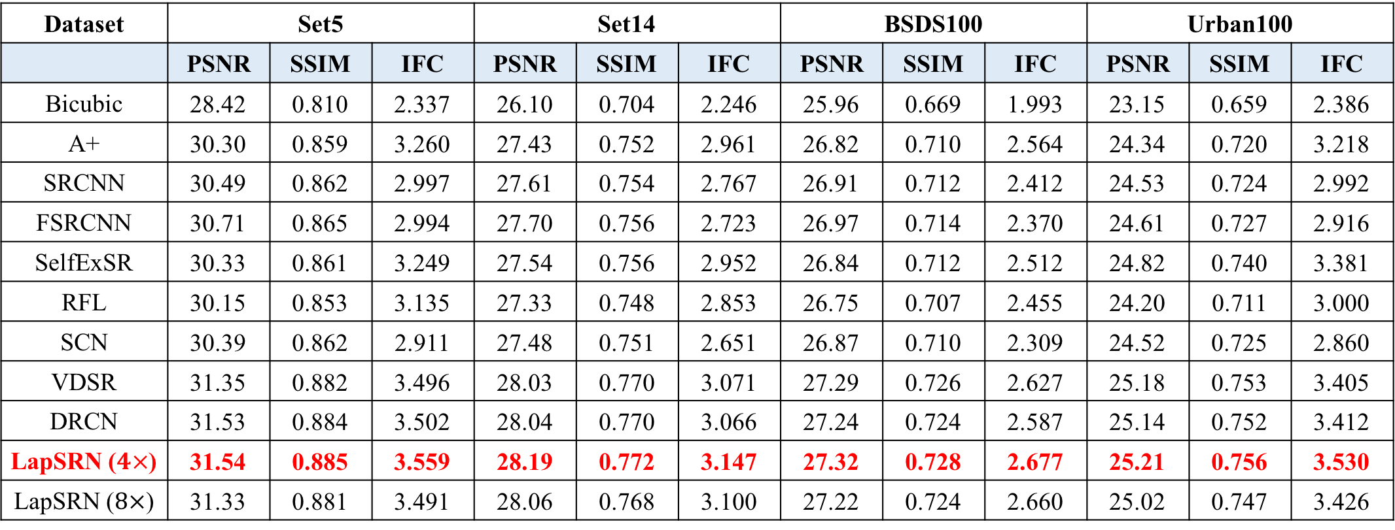
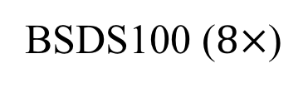
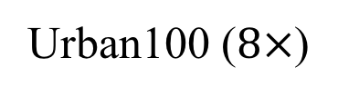
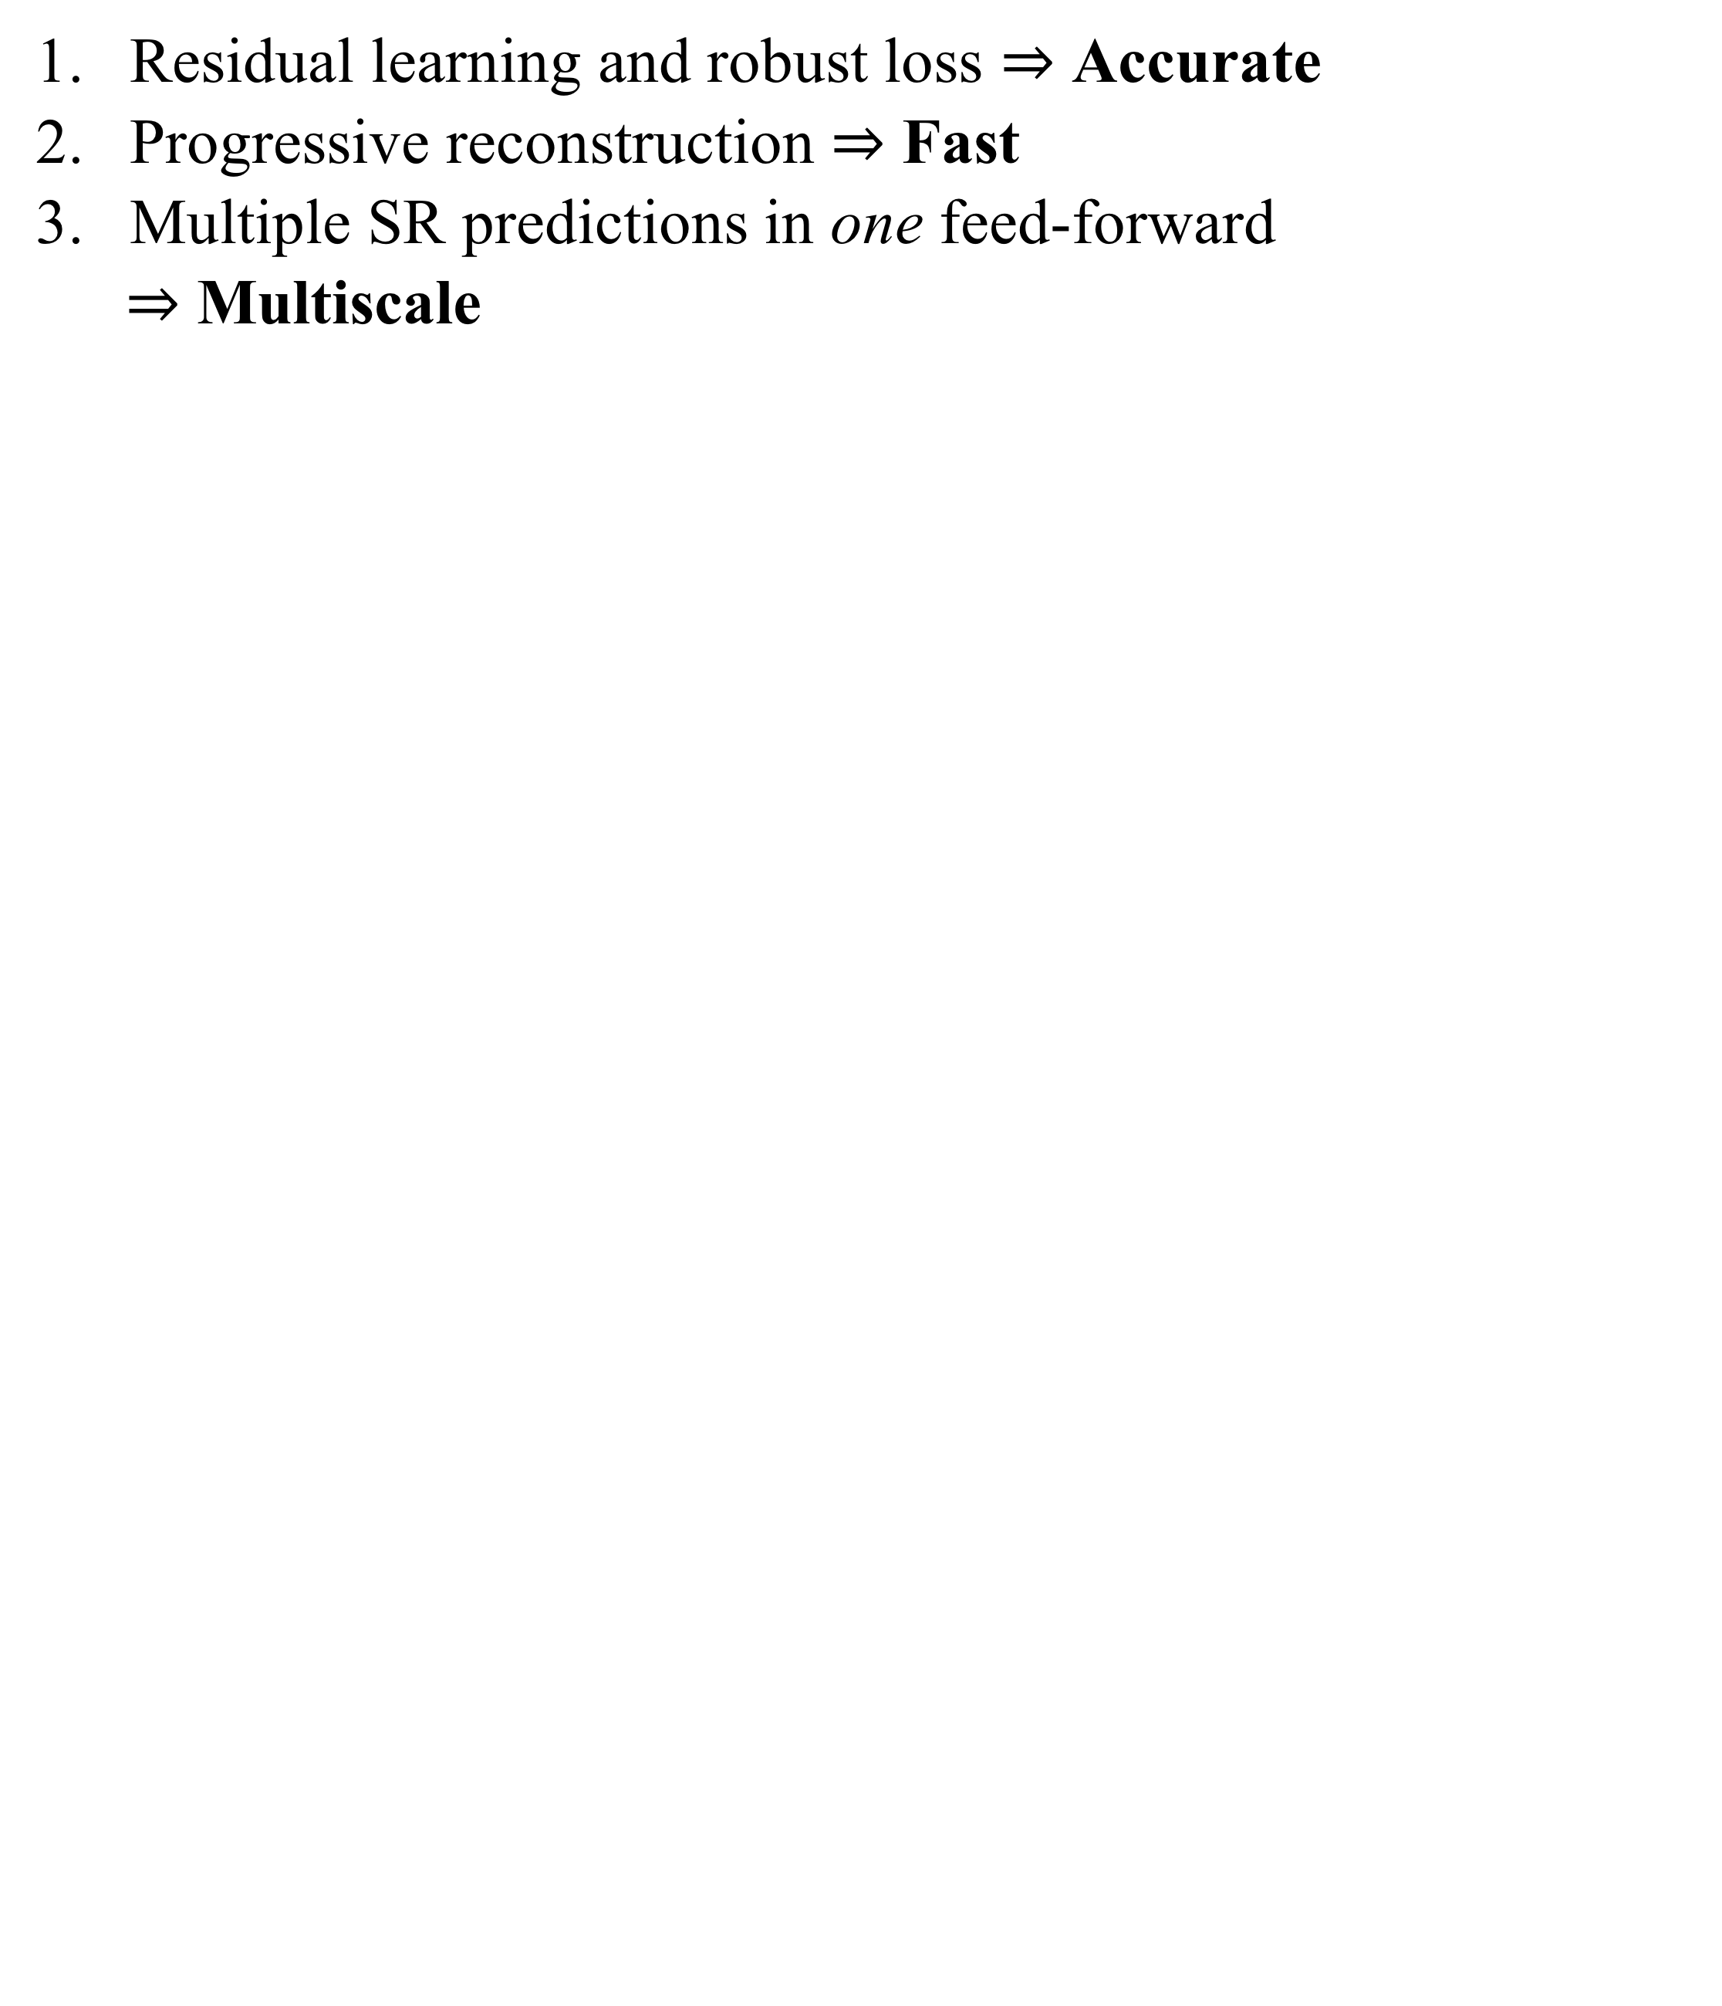
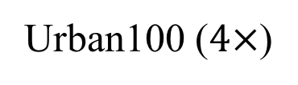
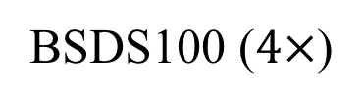
Deep Laplacian Pyramid Network for Fast and Accurate Super-Resolution
Wei-Sheng Lai¹, Jia-Bin Huang², Narendra Ahuja³, Ming-Hsuan Yang¹
¹University of California, Merced, ²Virginia Tech, ³University of Illinois, Urbana-Champaign
Project website: http://bit.ly/LapSRN-CVPR17
Contributions
Ablation Study
Visual Results
Residual learning and robust loss $⇒$ Accurate
Progressive reconstruction $⇒$ Fast
Multiple SR predictions in one feed-forward
$⇒$ Multiscale
HR
Bicubic
A+
SelfExSR
Code and results available at:
BSDS100 ($4×$)
FSRCNN
VDSR
DRCN
LapSRN (ours)
Network Architecture
HR
Bicubic
A+
SelfExSR
Urban100 ($4×$)
FSRCNN
VDSR
DRCN
LapSRN (ours)
Accurate
[Kim et al. CVPR 2016]
Fast
[Shi et al. CVPR 2016] [Dong et al. ECCV 2016]
HR
Bicubic
A+
SelfExSR
HR image
w/o pyramid
structure
w/o residual
learning
w/o robust
loss
Full model
Ground truth
BSDS100 ($8×$)
SRCNN
FSRCNN
VDSR
LapSRN (ours)
Quantitative Evaluation ($4×$ SR)
HR
Bicubic
A+
SelfExSR
Dataset | Set5 |  |  | Set14 |  |  | BSDS100 |  |  | Urban100
 | PSNR | SSIM | IFC | PSNR | SSIM | IFC | PSNR | SSIM | IFC | PSNR | SSIM | IFC
Bicubic | 28.42 | 0.810 | 2.337 | 26.10 | 0.704 | 2.246 | 25.96 | 0.669 | 1.993 | 23.15 | 0.659 | 2.386
A+ | 30.30 | 0.859 | 3.260 | 27.43 | 0.752 | 2.961 | 26.82 | 0.710 | 2.564 | 24.34 | 0.720 | 3.218
SRCNN | 30.49 | 0.862 | 2.997 | 27.61 | 0.754 | 2.767 | 26.91 | 0.712 | 2.412 | 24.53 | 0.724 | 2.992
FSRCNN | 30.71 | 0.865 | 2.994 | 27.70 | 0.756 | 2.723 | 26.97 | 0.714 | 2.370 | 24.61 | 0.727 | 2.916
SelfExSR | 30.33 | 0.861 | 3.249 | 27.54 | 0.756 | 2.952 | 26.84 | 0.712 | 2.512 | 24.82 | 0.740 | 3.381
RFL | 30.15 | 0.853 | 3.135 | 27.33 | 0.748 | 2.853 | 26.75 | 0.707 | 2.455 | 24.20 | 0.711 | 3.000
SCN | 30.39 | 0.862 | 2.911 | 27.48 | 0.751 | 2.651 | 26.87 | 0.710 | 2.309 | 24.52 | 0.725 | 2.860
VDSR | 31.35 | 0.882 | 3.496 | 28.03 | 0.770 | 3.071 | 27.29 | 0.726 | 2.627 | 25.18 | 0.753 | 3.405
DRCN | 31.53 | 0.884 | 3.502 | 28.04 | 0.770 | 3.066 | 27.24 | 0.724 | 2.587 | 25.14 | 0.752 | 3.412
LapSRN ($4×$) | 31.54 | 0.885 | 3.559 | 28.19 | 0.772 | 3.147 | 27.32 | 0.728 | 2.677 | 25.21 | 0.756 | 3.530
LapSRN ($8×$) | 31.33 | 0.881 | 3.491 | 28.06 | 0.768 | 3.100 | 27.22 | 0.724 | 2.660 | 25.02 | 0.747 | 3.426
Urban100 ($8×$)
SRCNN
FSRCNN
VDSR
LapSRN (ours)
Adversarial Training
Limitations
HR
Bicubic
Accurate and Fast (proposed)
Ground Truth
LapSRN
LapSRN + adv.
Urban100 ($8×$)
VDSR
LapSRN (ours)

